Slide 1
Calculator

Slide 2
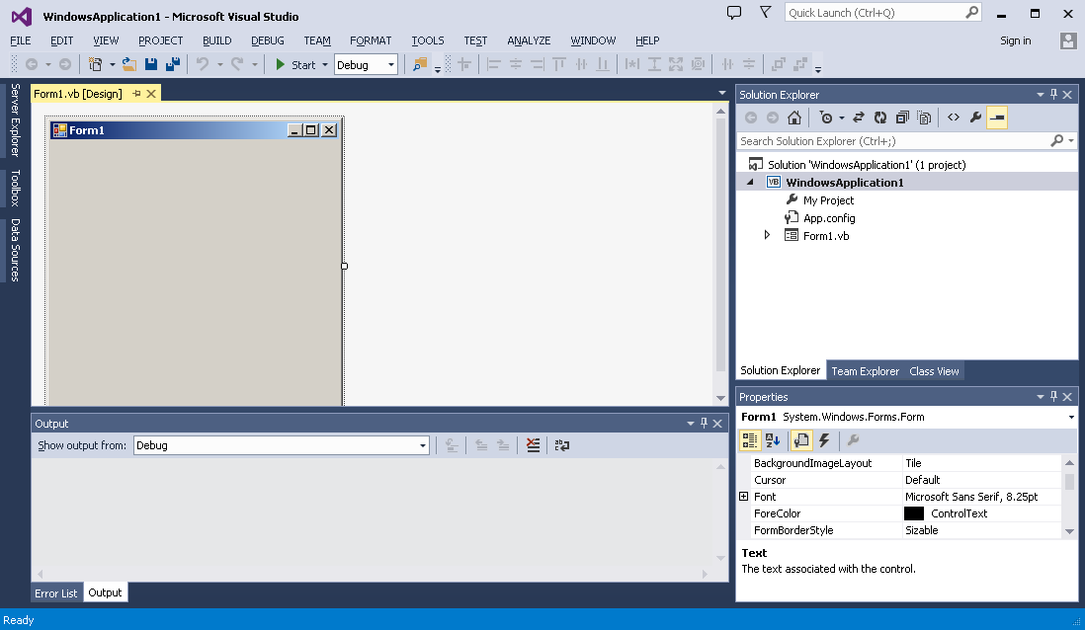
Window Application: Simple Calculator

Slide 3
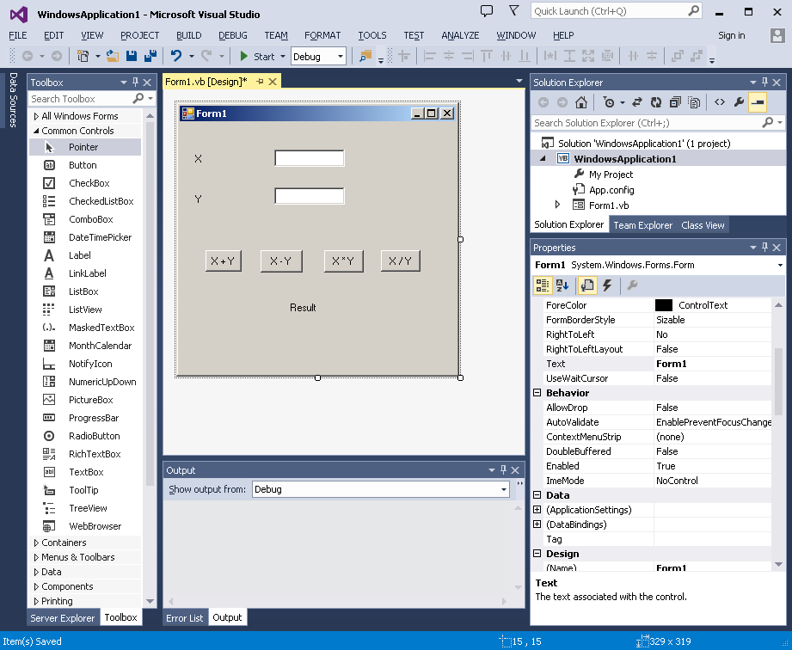
Window Application: Simple Calculator

Slide 4
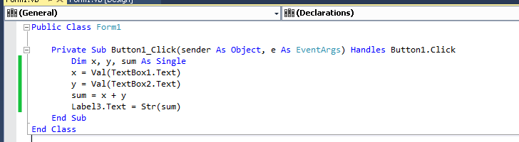
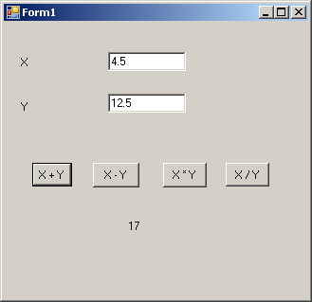
Window Application: Simple Calculator
Notes:
The str() function converts values to a string form so they can be combined with other strings.
We can use declaration one time in public class for all sub to avoid repeat it.

Slide 5
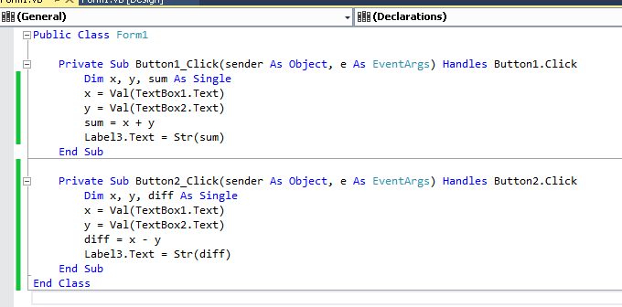
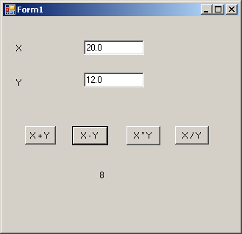
Window Application: Simple Calculator
Notes:
It can give same variable name on each sub

Slide 6
Window Application: Simple Calculator
Write subroutines for the following event handler when the user click on the selected buttons, as shown in the figure below:
X * Y
X / Y

Slide 7
Microsoft Visual Studio
Window Form Application

Slide 8
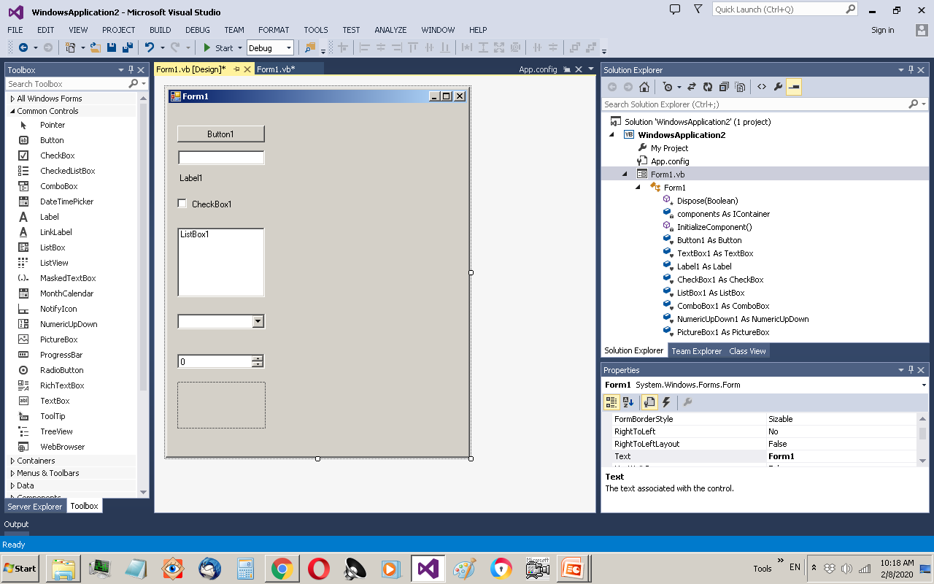

Slide 9
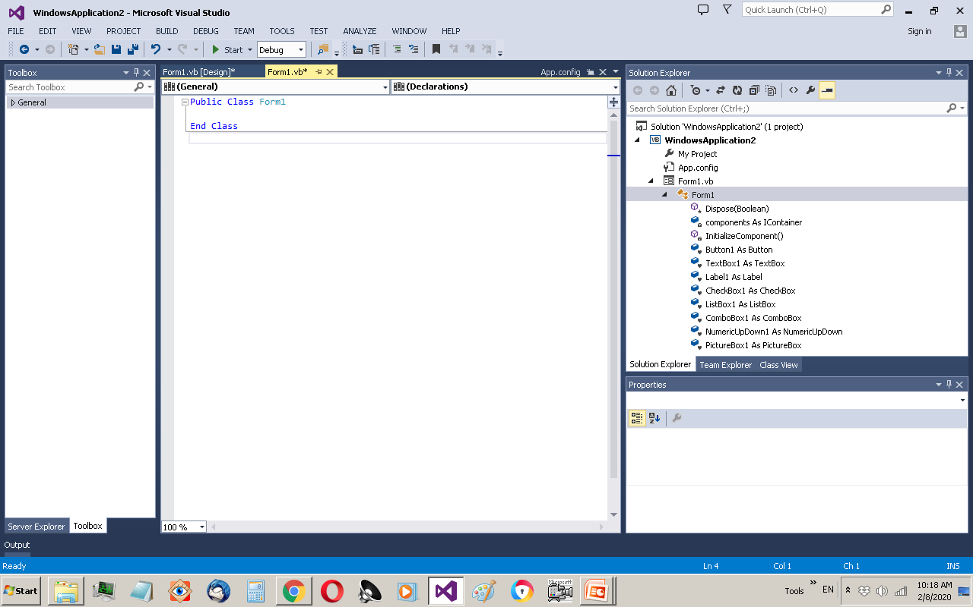

Slide 10
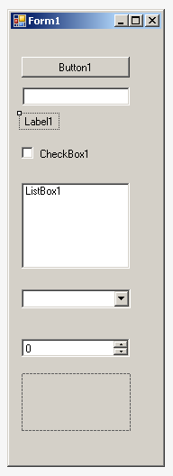
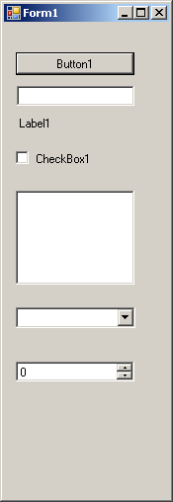
Controls (Found in Toolbox, left hand side)
Button
TextBox
Label
CheckBox
ListBox
ComboBox
NumericUpDown
PictureBox
Design view
Run view

Slide 11
Properties (Right hand side)
The following are the properties for TextBox
Accessibility
Appearance: BackColor, ForeColor, Font (Name, size, ..), Text, TextAlign
Behavior: Enabled, Multiline, ReadOnly, MaxLength, …
Data: DataBindings
Design: Name
Layout: Location, Size, …

Slide 12
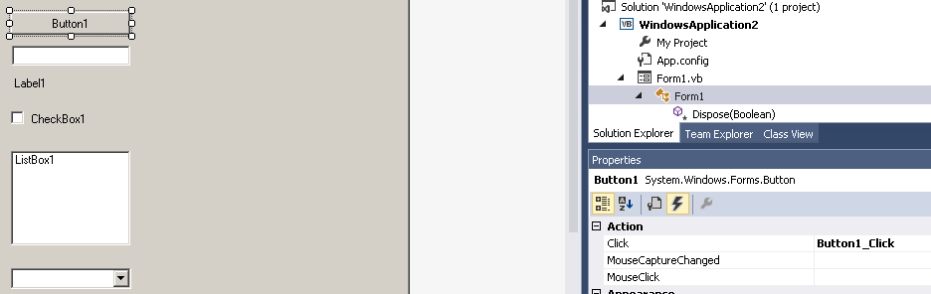
Events (actions)
The following are subset of events associate to button control
Button1_Click, Button1_MouseClick, …
events
Notes:
Double click and mouse click
Backspace to delete event

Slide 13
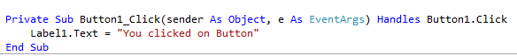
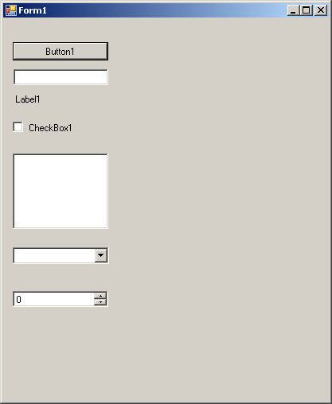

Click on button event

Slide 14
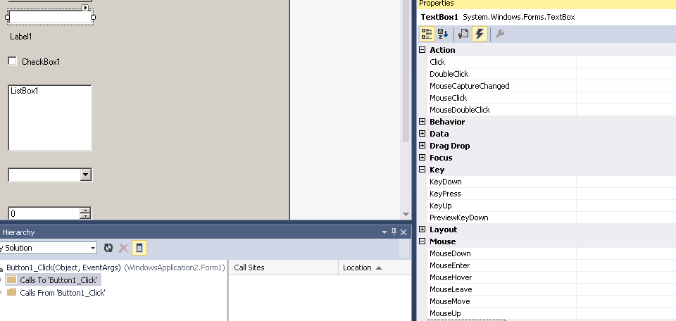
Events (actions)
The following are subset of events associate to TextBox control
TextBox1_Click, TextBox1_MouseClick, …
events

Slide 15

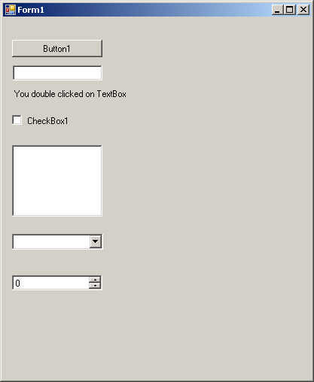
Double Click on TextBox event

Slide 16
Check this example

Slide 17
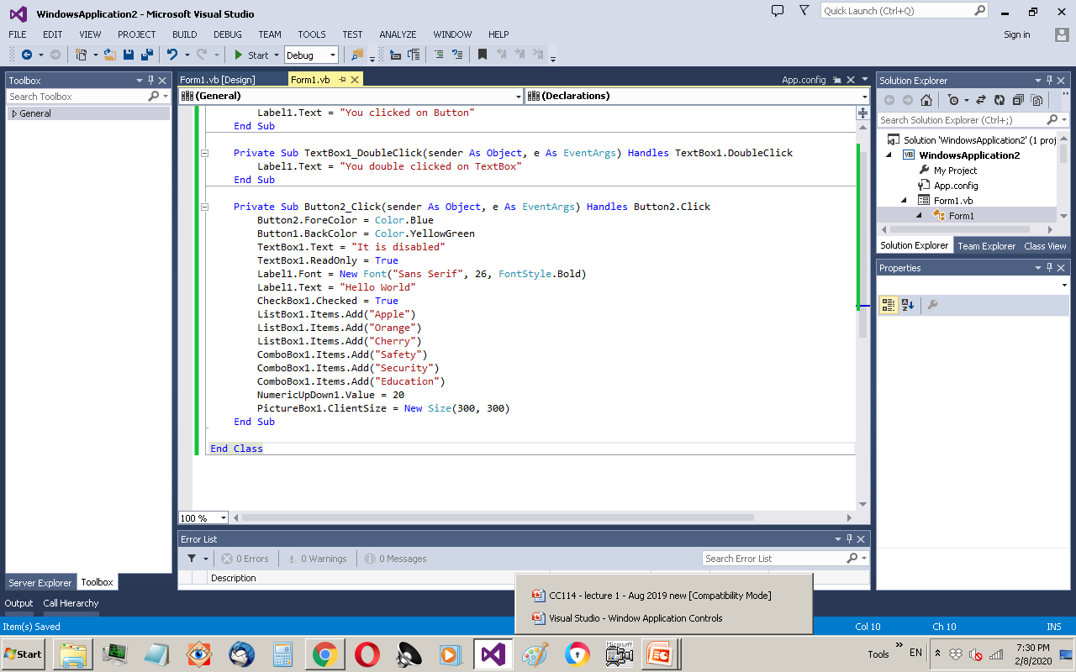
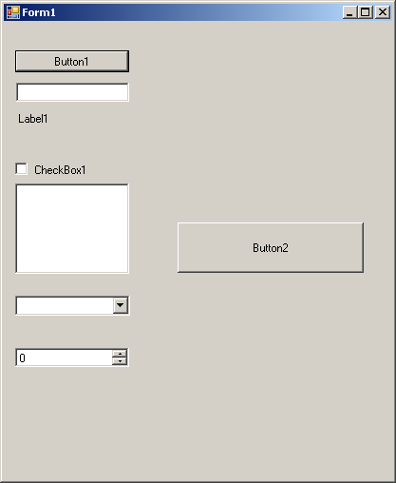
Notes:
Picturebox prop= size mode= stretch
Read only mean not editable

Slide 18
